Slide 1
Graph Partitioning Algorithms: Balancing Nodes and Edges in Discrete Optimization

Slide 2
OBJECTIVES:
Minimize Cut Size:
One of the primary objectives in graph partitioning is to minimize the number of edges (or total edge weight) that cross partition boundaries. This objective is often formulated as minimizing the cut size or the total weight of cut edges between partitions.
Examples of algorithms optimizing this objective include spectral partitioning, Kernighan-Lin algorithm, and multilevel graph partitioning methods.
Balance Partition Sizes:
Ensuring that the partitions have roughly equal sizes (i.e., an approximately equal number of nodes or total node weight) is another important objective. Balanced partition sizes help distribute computational workload evenly in parallel computing and maintain fairness in resource allocation.
Various partitioning algorithms incorporate techniques to achieve balanced partition sizes, such as recursive bisection and multi-constraint graph partitioning.

Slide 3
Maximize Intra-Partition Connectivity
While minimizing cut size is important, it's also essential to ensure that the nodes within each partition are well-connected. Maximizing the intra-partition connectivity helps maintain the coherence and integrity of the partitions.
Certain partitioning algorithms aim to optimize this objective by considering intra-partition edge density or conductance metrics.
Preserve Graph Structure:
In some cases, preserving the underlying structure or properties of the original graph is a key objective. This includes maintaining community structures, preserving hierarchical relationships, or retaining certain graph properties such as degree distribution.
Algorithms like modularity-based partitioning methods focus on identifying and preserving communities or clusters within the graph.

Slide 4
Reduce Communication Costs:
In distributed computing and network design applications, minimizing communication costs between partitions is critical. This objective involves minimizing the amount of information exchanged between partitions or reducing the distance between communicating nodes.
Partitioning algorithms designed for distributed computing often optimize communication costs by considering network bandwidth, latency, and message passing overhead.
Maximize Modularity or Clustering Coefficient:
Some partitioning objectives aim to maximize the modularity or clustering coefficient within each partition. Modularity measures the density of connections within communities, while the clustering coefficient quantifies the degree to which nodes tend to cluster together.
Partitioning algorithms based on modularity optimization attempt to maximize the modularity score by iteratively reassigning nodes to partitions to improve community structure.

Slide 5
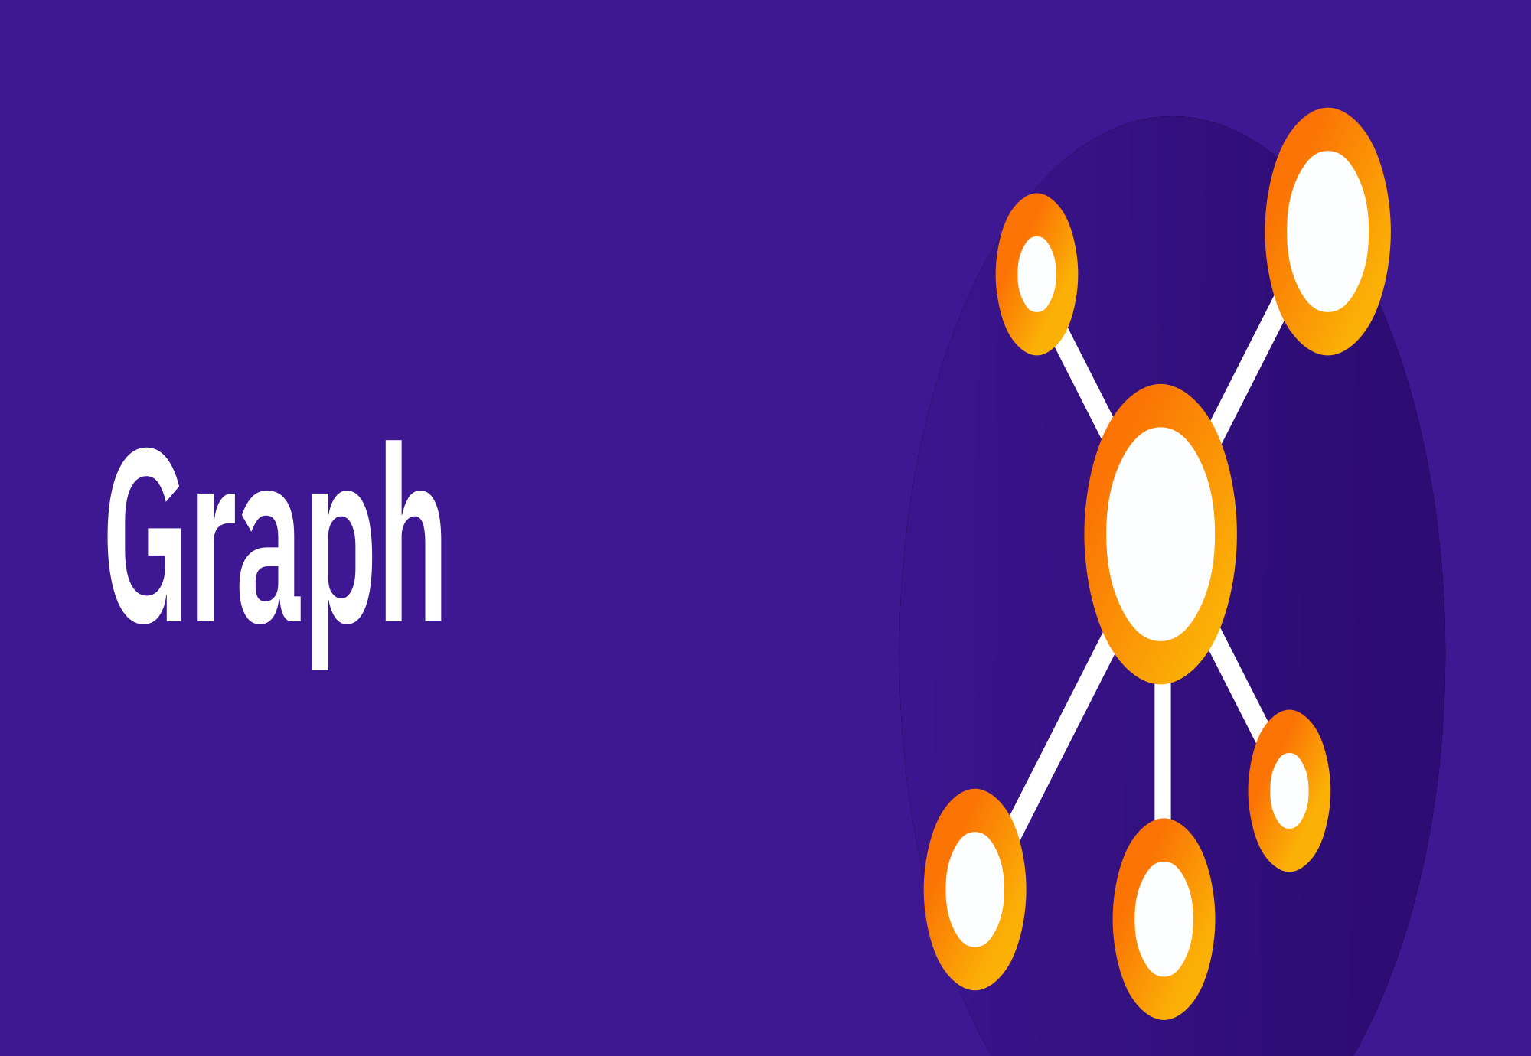

Slide 6
GRAPH INTRODUCTION
A Graph is a non-linear data structure consisting of vertices and edges. The vertices are sometimes also referred to as nodes and the edges are lines or arcs that connect any two nodes in the graph. More formally a Graph is composed of a set of vertices( V ) and a set of edges( E ). The graph is denoted by G(V, E).
Graph data structures are a powerful tool for representing and analyzing complex relationships between objects or entities. They are particularly useful in fields such as social network analysis, recommendation systems, and computer networks

Slide 7
In the field of sports data science, graph data structures can be used to analyze and understand the dynamics of team performance and player interactions on the field.
Imagine a game of football as a web of connections, where players are the nodes and their interactions on the field are the edges. This web of connections is exactly what a graph data structure represents, and it’s the key to unlocking insights into team performance and player dynamics in sports.

Slide 8
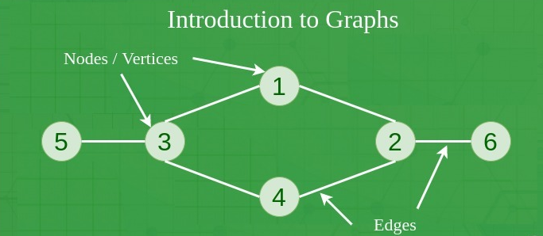

Slide 9
COMPONENTS OF A GRAPH
Vertices: Vertices are the fundamental units of the graph. Sometimes, vertices are also known as vertex or nodes. Every node/vertex can be labeled or unlabelled.
Edges: Edges are drawn or used to connect two nodes of the graph. It can be ordered pair of nodes in a directed graph. Edges can connect any two nodes in any possible way. There are no rules. Sometimes, edges are also known as arcs. Every edge can be labelled/unlabelled.

Slide 10
Weight: A weight can be assigned to an edge, representing the cost or distance between two vertices. A weighted graph is a graph where the edges have weights.
Degree: The degree of a vertex is the number of edges that connect to it. In a directed graph, the in-degree of a vertex is the number of edges that point to it, and the out-degree is the number of edges that start from it.
Path: A path is a sequence of vertices that are connected by edges. A simple path does not contain any repeated vertices or edges.
Cycle: A cycle is a path that starts and ends at the same vertex. A simple cycle does not contain any repeated vertices or edges.
Connectedness: A graph is said to be connected if there is a path between any two vertices. A disconnected graph is a graph that is not connected.

Slide 11
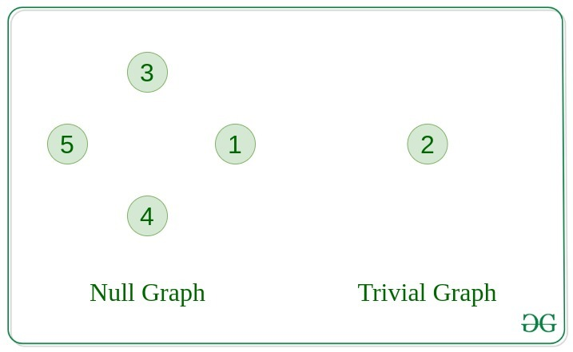
TYPES OF GRAPH
Null Graph
A graph is known as a null graph if there are no edges in the graph.
Trivial Graph
Graph having only a single vertex, it is also the smallest graph possible

Slide 12
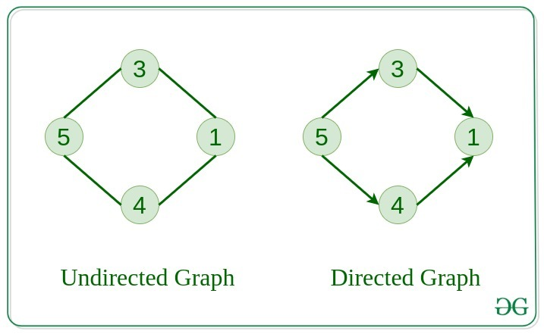
Undirected Graph
A graph in which edges do not have any direction. That is the nodes are unordered pairs in the definition of every edge.
Directed Graph
A graph in which edge has direction. That is the nodes are ordered pairs in the definition of every edge.

Slide 13
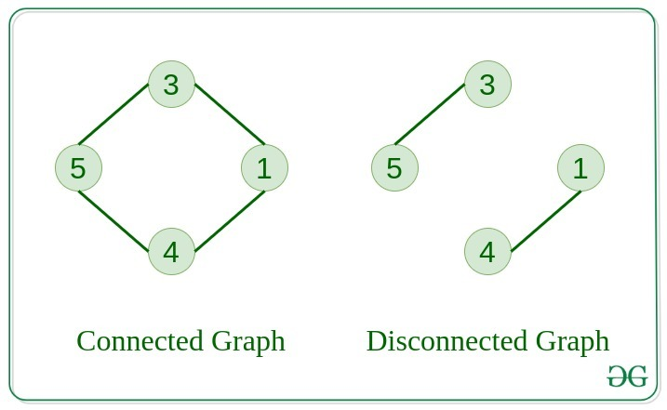
Connected Graph
The graph in which from one node we can visit any other node in the graph is known as a connected graph.
Disconnected Graph
The graph in which at least one node is not reachable from a node is known as a disconnected graph.

Slide 14
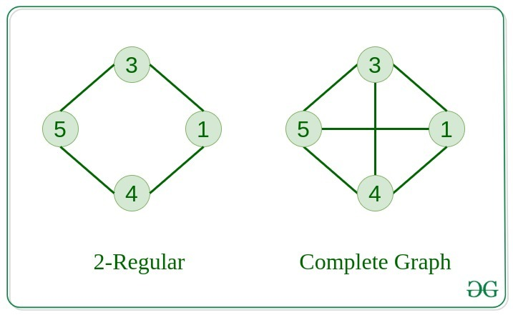
Regular Graph
The graph in which the degree of every vertex is equal to K is called K regular graph.
Complete Graph
The graph in which from each node there is an edge to each other node.

Slide 15
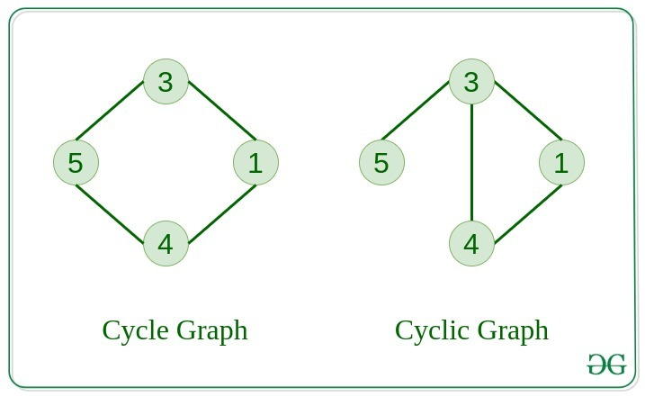
Cycle Graph
The graph in which the graph is a cycle in itself, the degree of each vertex is 2.
Cyclic Graph
A graph containing at least one cycle is known as a Cyclic graph.

Slide 16
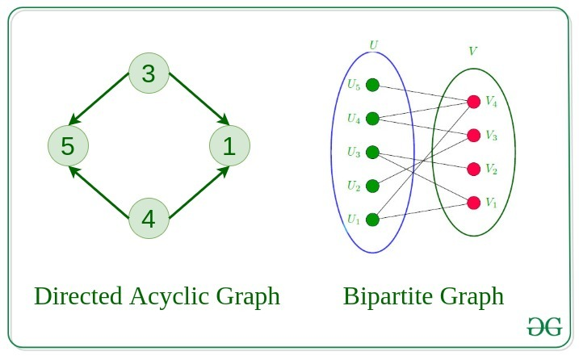
Directed Acyclic Graph
A Directed Graph that does not contain any cycle.
Bipartite Graph
A graph in which vertex can be divided into two sets such that vertex in each set does not contain any edge between them.

Slide 17
Weighted Graph
A graph in which the edges are already specified with suitable weight is known as a weighted graph.
Weighted graphs can be further classified as directed weighted graphs and undirected weighted graphs.

Slide 18
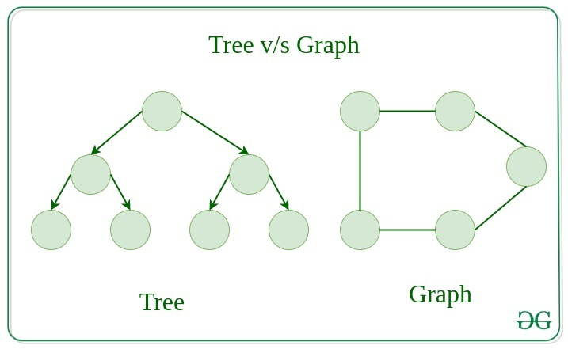
Tree v/s Graph
Trees are the restricted types of graphs, just with some more rules. Every tree will always be a graph but not all graphs will be trees. Linked List, Trees, and Heaps all are special cases of graphs.

Slide 19
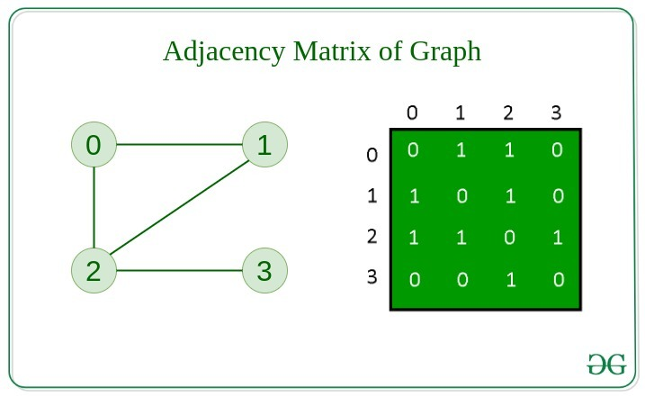
REPRESENTATION OF GRAPHS
There are two ways to store a graph:
Adjacency Matrix
Adjacency List
Adjacency Matrix
In this method, the graph is stored in the form of the 2D matrix where rows and columns denote vertices. Each entry in the matrix represents the weight of the edge between those vertices.

Slide 20
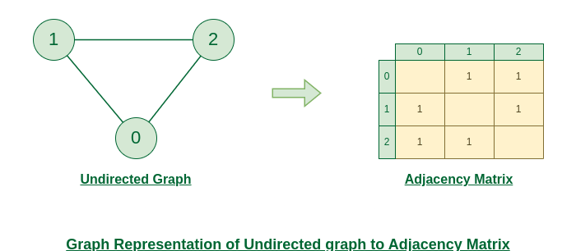

Slide 21
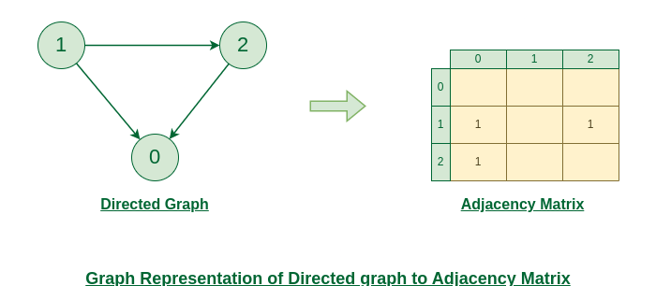

Slide 22
Basic Operations on Graphs
Below are the basic operations on the graph:
Insertion of Nodes/Edges in the graph – Insert a node into the graph.
Deletion of Nodes/Edges in the graph – Delete a node from the graph.
Searching on Graphs – Search an entity in the graph.
Traversal of Graphs – Traversing all the nodes in the graph.
Usage of graphs
Maps can be represented using graphs and then can be used by computers to provide various services like the shortest path between two cities.
When various tasks depend on each other then this situation can be represented using a Directed Acyclic graph and we can find the order in which tasks can be performed using topological sort.
State Transition Diagram represents what can be the legal moves from current states. In-game of tic tac toe this can be used.

Slide 23
Real-Time Applications of Graph:
Social media analysis: Social media platforms generate vast amounts of data in real-time, which can be analyzed using graphs to identify trends, sentiment, and key influencers. This can be useful for marketing, customer service, and reputation management.
Network monitoring: Graphs can be used to monitor network traffic in real-time, allowing network administrators to identify potential bottlenecks, security threats, and other issues. This is critical for ensuring the smooth operation of complex networks.
Financial trading: Graphs can be used to analyze real-time financial data, such as stock prices and market trends, to identify patterns and make trading decisions. This is particularly important for high-frequency trading, where even small delays can have a significant impact on profits.
Internet of Things (IoT) management: IoT devices generate vast amounts of data in real-time, which can be analyzed using graphs to identify patterns, optimize performance, and detect anomalies. This is important for managing large-scale IoT deployments.
Autonomous vehicles: Graphs can be used to model the real-time environment around autonomous vehicles, allowing them to navigate safely and efficiently. This requires real-time data from sensors and other sources, which can be processed using graph algorithms.
Disease surveillance: Graphs can be used to model the spread of infectious diseases in real-time, allowing health officials to identify outbreaks and implement effective containment strategies. This is particularly important during pandemics or other public health emergencies.
The best example of graphs in the real world is Facebook. Each person on Facebook is a node and is connected through edges. Thus, A is a friend of B. B is a friend of C, and so on.

Slide 24
PARTITION A GRAPH

Slide 25
Partitioning Algorithms
Kernighan-Lin Algorithm: Iteratively swaps pairs of nodes between partitions to improve a given objective function, often minimizing the edge-cut.
Metis: Uses multilevel techniques to recursively coarsen the graph, partitioning the coarsest level and then refining the partitions at finer levels.
Spectral Partitioning: Based on the eigenvalues of the graph Laplacian matrix, it partitions the graph by clustering nodes according to the eigenvectors associated with the smallest eigenvalues.
Recursive Bisection: Repeatedly divides the graph into two partitions until a desired balance is achieved, often using algorithms like spectral bisection or median-based partitioning.
Simulated Annealing: Uses a probabilistic optimization technique inspired by the annealing process in metallurgy to explore the solution space and gradually reduce the imbalance.

Slide 26
Spectral Partitioning
Spectral partitioning algorithms find approximate solutions to graph partitioning problems by computing one or more eigenvectors of a symmetric matrix that represents the connectivity of the graph, then inferring a cut from the eigenvectors.
Spectral graph theory is the study of properties of the Laplacian matrix or adjacency matrix associated with a graph.
What are spectral methods for graph clustering?
Spectral clustering algorithms are mostly based on the solution of graph cut problems. For such, they use one or more eigenvectors from Laplacian matrices of a graph to be partitioned that are solutions for the relaxation of some graph cut problems.

Slide 27
Difference Between Cluster and Partition
The terms "cluster" and "partition" are related concepts, but they are not exactly the same and are often used in different contexts
Cluster: In the context of data analysis or machine learning, a cluster refers to a group of data points that are similar to each other and dissimilar to data points in other clusters. Clustering algorithms are used to group similar data points together based on certain criteria, such as distance or similarity measures. Clustering is often applied to unlabeled data for tasks like segmentation, pattern recognition, or anomaly detection.
Partition: In the context of graph theory and optimization, partitioning refers to the division of a graph into disjoint subsets or partitions. The objective of graph partitioning algorithms is to divide the nodes of the graph into groups such that certain criteria are optimized. Common objectives include minimizing the number of edges between partitions, balancing the sizes of partitions, or maximizing the cohesion(similarity) within partitions. Graph partitioning is often applied to tasks like load balancing, parallel computing, network design, or data organization.
While both concepts involve grouping elements together based on certain criteria, clusters are typically associated with data points in a feature space, whereas partitions are associated with nodes or components in a graph. However, there can be overlap between the two concepts, especially in applications where data points are represented as nodes in a graph and clustering algorithms are applied to partition the graph into meaningful subsets.

Slide 28
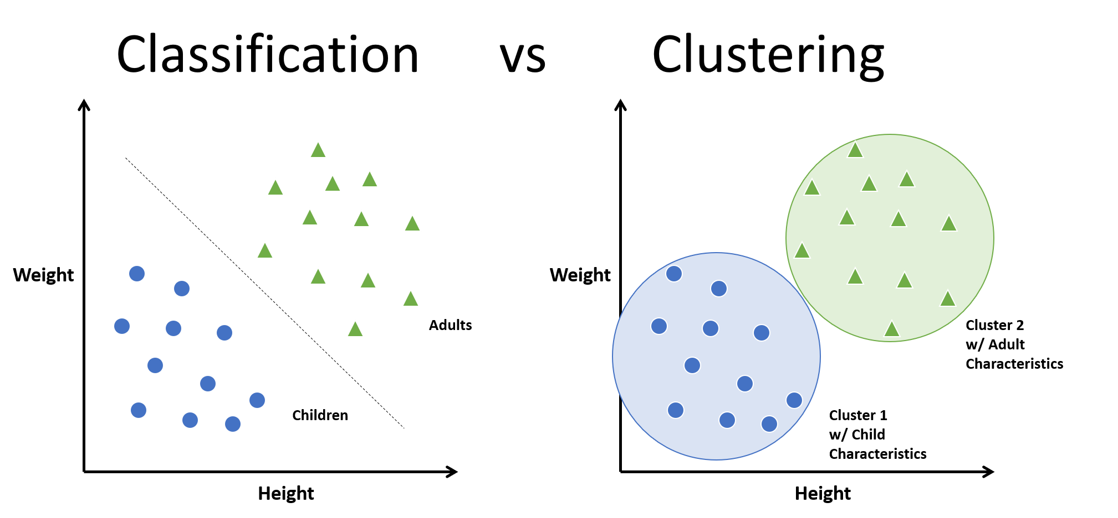

Slide 29
As humans, in machine learning, a widely used unsupervised algorithm to group unlabeled data points by similarity and distance measures is clustering.
If the data points are labeled, grouping is known as classification.
Clustering algorithms have their application in many places including anomaly detection, image segmentation, search result grouping, market segmentation, and social network analysis.
Clustering is one of the initial steps done in exploratory data analysis to visualize the similarity and to identify the pattern lying hidden in data points.
The motive of clustering is to find the similarity within a cluster and the difference between two clusters.
Support Vector Machines, Decision trees, Random forests, Linear classifiers and Neural networks are few classification algorithms whereas K means clustering, Fuzzy analysis clustering, Mean shift, DBSCAN and Spectral are clustering algorithms.

Slide 30
There are two major approaches in clustering.
They are:
Compactness
Connectivity
In compactness, the points are closer to each other and are compact towards the cluster center. Distance is used as a measure to compute closeness. There are different types of distance metrics that are in use. A few of them are Euclidean distance, Manhattan distance, Minkowski distance, and Hamming distance. K-means algorithm uses the compactness approach.
In connectivity, the points in a cluster are either immediately next to each other (epsilon distance) or connected. Even if the distance is less, they are not put in the same cluster. Spectral clustering is one of the techniques to follow this approach.

Slide 31
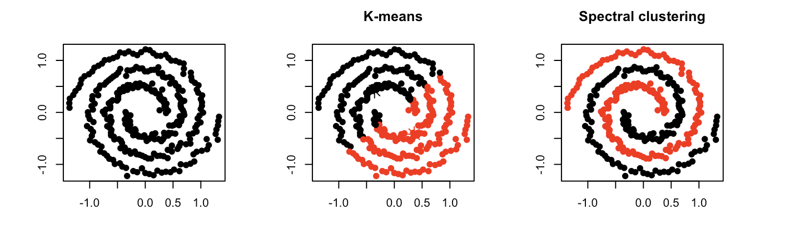
Compactness
Connectivity

Slide 32
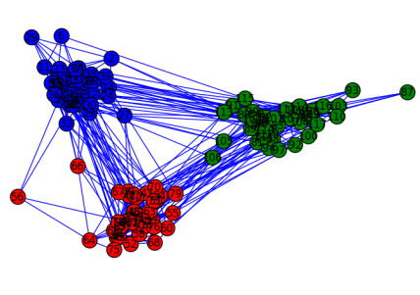
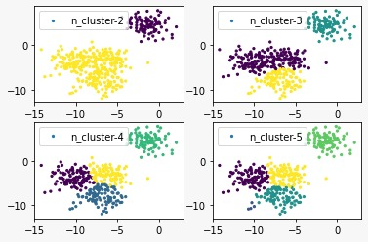
Partition ---> represent a node
Cluster ---> represent data points

Slide 33
Spectral Partitioning
How to do Spectral Clustering?
The three major steps involved in spectral clustering are: constructing a similarity graph, projecting data onto a lower-dimensional space, and clustering the data. Given a set of points S in a higher-dimensional space, it can be elaborated as follows:
1. Form a distance matrix
2. Transform the distance matrix into an affinity matrix A
3. Compute the degree matrix D and the Laplacian matrix L = D – A.
4. Find the eigenvalues and eigenvectors of L.
5. With the eigenvectors of k largest eigenvalues computed from the previous step form a matrix.
6. Normalize the vectors.
7. Cluster the data points in k-dimensional space.
K-means algorithm generally assumes that the clusters are spherical or round
In spectral, the clusters do not follow a fixed shape or pattern.

Slide 34
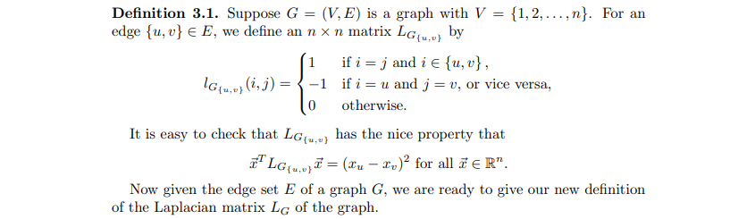
Basic Properties of The Laplacian Matrix
One of the most interesting properties of a graph is its connectedness. TheLaplacian matrix provides us with a way to investigate this property. In this section,we study the properties of the Laplacian matrix of a graph. First, we give a newway to define the Laplacian matrix for a graph, which turns out to be much more useful than the previous one

Slide 35
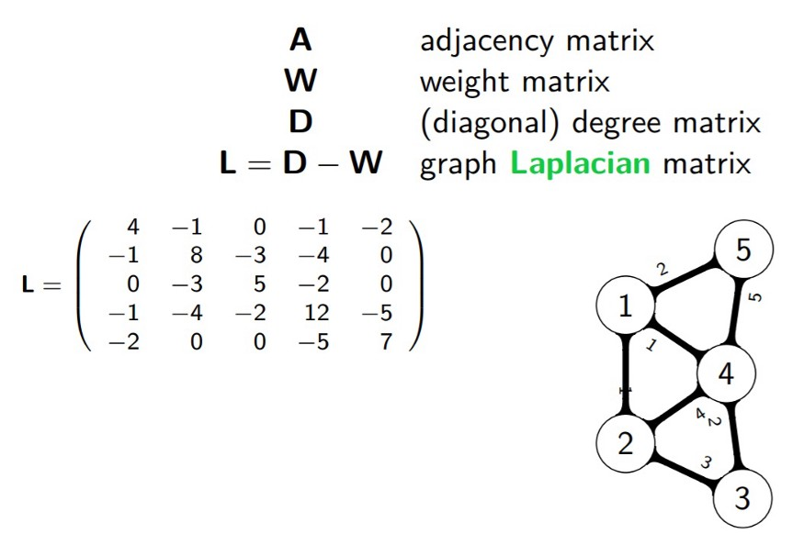
Then find eigen values and eigen vectors to laplacian matrix.
finally split into partition of graph with usung this method.

Slide 36
Applications
Parallel Computing:
In parallel computing, tasks are often divided among multiple processors or computing units. Graph partitioning algorithms can be used to efficiently distribute computational tasks across these units, ensuring a balanced workload to minimize overall execution time.
Network Design:
In network design, particularly in telecommunications or computer networks, optimizing the placement of nodes and edges is crucial for minimizing latency, congestion, and resource usage. Graph partitioning algorithms can help design efficient network topologies by balancing the load across nodes and edges.

Slide 37
Data Clustering:
Graph partitioning algorithms can be applied to data clustering problems where the goal is to group similar data points together. By representing data as a graph and partitioning it into subgraphs, these algorithms can efficiently identify clusters while ensuring a balanced distribution of data points across clusters.
VLSI Design:
In Very Large Scale Integration (VLSI) design, where circuits are implemented on silicon chips, graph partitioning techniques are used to partition the circuit layout into smaller modules. This helps in optimizing various metrics such as wire length, area, and power consumption.
Scientific Computing:
In scientific computing, graph partitioning algorithms are used to partition large-scale computational meshes or grids. This enables efficient parallelization of numerical simulations and computations, leading to faster solution times for problems in physics, engineering, and other scientific disciplines.
Image and Video Processing:
Graph partitioning techniques are also applied in image and video processing tasks such as image segmentation and video summarization. By representing images or videos as graphs, partitioning algorithms can be used to group pixels or frames into coherent segments or clusters based on similarity metrics.

Slide 38
ALGORITHM

Slide 39
Spectral Partitioning Algorithm:
Input:
G: The input graph.
num_partitions: The desired number of partitions.
Output:
Partition labels for each node in the graph.
Steps:
Compute the Laplacian Matrix:
Compute the Laplacian matrix L of the input graph
G. The Laplacian matrix is defined as
L=D−A, where D is the degree matrix and A is the adjacency matrix of G.
Compute Eigenvalues and Eigenvectors:
Compute the eigenvalues and corresponding eigenvectors of the Laplacian matrix L.
Sort the eigenvalues in ascending order and select the k smallest eigenvalues
(where k=num_partition).

Slide 40
Partitioning:
Form a matrix X containing the k eigenvectors corresponding to the selected eigenvalues.
Use a clustering algorithm (e.g., k-means clustering) to cluster the rows of X into k partitions.
Assign each node in the graph G to the partition represented by the cluster it belongs to.
Output:
Return the partition labels assigned to each node in the graph.
Notes:
Spectral partitioning aims to minimize the normalized cut or ratio cut objective functions, which measure the quality of partitions based on the number of edges between partitions.
The number of partitions is typically specified by the user as a parameter to the algorithm.
Spectral partitioning can be applied to both undirected and weighted graphs.
The choice of clustering algorithm and the method used to select eigenvalues/eigenvectors can affect the performance and results of spectral partitioning.

Slide 41
Complexity:
The complexity of spectral partitioning mainly depends on the eigenvalue decomposition step, which typically has a complexity of O(n3), where n is the number of nodes in the graph.
However, practical implementations often use approximation techniques and optimizations to improve efficiency.

Slide 42
FLOWCHART

Slide 43
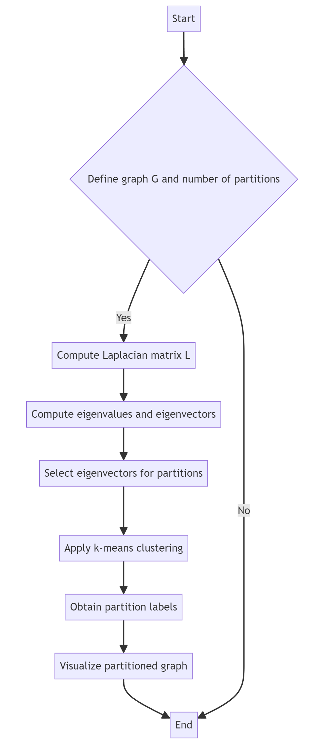

Slide 44
IMPLEMENTATION

Slide 45
import networkx as nx
import numpy as np
import matplotlib.pyplot as plt
def spectral_partitioning(G, num_partitions):
# Compute the Laplacian matrix
L = nx.laplacian_matrix(G).toarray()
# Compute the eigenvectors corresponding to the smallest eigenvalues
eigenvalues, eigenvectors = np.linalg.eigh(L)
smallest_indices = np.argsort(eigenvalues)[:num_partitions]
partition_vectors = eigenvectors[:, smallest_indices]
# Use k-means clustering to partition the nodes based on the eigenvectors
from sklearn.cluster import KMeans
kmeans = KMeans(n_clusters=num_partitions, random_state=0)
partition_labels = kmeans.fit_predict(partition_vectors)
return partition_labels

Slide 46
def visualize_partitioned_graph(G, partition_labels):
pos = nx.spring_layout(G)
colors = ['r', 'g', 'b', 'y', 'c', 'm', 'orange', 'pink', 'lime', 'purple']
partition_color_map = {i: colors[partition_labels[i]] for i in range(len(partition_labels))}
node_colors = [partition_color_map[i] for i in range(len(G.nodes))]
nx.draw(G, pos, node_color=node_colors, with_labels=True)
plt.show()
# Example usage
G = nx.karate_club_graph()
num_partitions = 9 # Adjust the number of partitions here
partition_labels = spectral_partitioning(G, num_partitions)
visualize_partitioned_graph(G, partition_labels)

Slide 47
END

